Slide 1
Notes:
Introduction. “Hi, my name is …. What do you all think Gatsby?”

Slide 2
Fiction and Life
Literature and History
Art of any kind is not created in a vacuum
New school vs Historicism
Influenced by the environment
Historical
Cultural
Psychological
Act of communication
Audience is key
Notes:
In my undergrad, I was an English major and, eventually, a history minor, because I believe that the context and the time that a work is written in is a reflection of the cultural and personal issues that the people in that time were struggling against. I think connecting literature to the context it was made in is what makes a lot of these old, old, old works written by dead people important because it shows us where we came from, especially in Western traditions.
Although some schools of thought would say the opposite, texts are not made in a vacuum. So they are influenced by their environment, whether that includes the historical moment or the author’s psychological and personal life, or all three are up the individual interpretations.
They also are influenced by audiences’ environment and backgrounds because effective communication requires successfully getting a message to an audience, and all art, in my opinion, is an act of communication. However, that doesn’t mean that interpretations made by an audience are always intended by the author or artist. This fact does not make the audiences’ interpretations any less valid. In fact, I would argue that the audiences’ interpretation is probably more valid than anything the author intended but didn’t succeed in communication. How the audience relates the texts to their own lives is, of course, more meaningful to them than some long forgotten commentary that the author meant to make.

Slide 3
F. Scott Fitzgerald
1896-1940
Non-graduating member of Princeton’s 1917 class
Rose to fame almost overnight with This Side of Paradise (1920)
Was the youngest novelist published by Scribners
Married Zelda Sayre of Alabama; had one daughter
Made most of his money off publishing short fiction in magazines
Ultimately published about 160 short stories, 4 novels, and one play
Autobiographical
Died believing he was a failure
Notes:
“And, perhaps more problematic for novels about Fitzgeralds, the couple did everything with such awful pacing. It’s awe-inspiring that lives can be structured so cruelly. There’s hardly time to anticipate the couple’s success before they succeed, or to enjoy their success before they start going to hell, and there’s no meaningful respite from their hell once they’ve arrived. There they remain (mired in alcoholism, marking time in mental institutions) until they die; young, but not glamorously so—forty-four in F. Scott’s case, forty-seven in Zelda’s” (Fischer).
Tumultuous relationship – Zelda threw herself down some stairs at a party because she thought Scott was getting too cozy with another female party-goer
“Babylon Revisited”
This Side of Paradise
The Great Gatsby
The Beautiful and Damned
Tender is the Night
The Vegetable

Slide 4
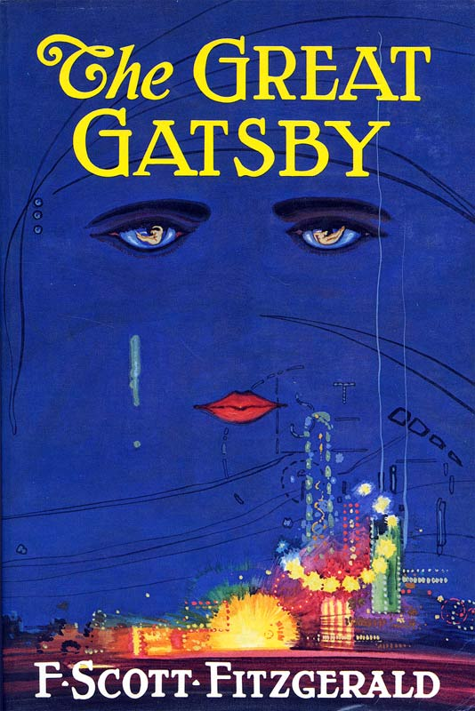
The Great Gatsby
1st Edition: 20,000 copies
2nd Edition: 3,000 copies
“Initial reviews … were not so much negative as unseeing” (Churchwell 305)
Hindsight
Seen as fluff fiction by contemporaries; “ripped from the headlines”
Notes:
The 2nd edition did not sell out until after Fitzgerald’s death
Hindsight: Gatsby’s “first readers could only see half of the meaning of the book, its entanglement with the facts and contexts of the day, and were blind to its transcendent meanings. We tend now to focus on those universal meanings, letting our myths and misapprehensions about the 1920s take the place of the facts about Fitzgerald’s world. Each moment mistakes the part for the whole, seeing only one side of his book, the other side obscured by the darkness of the era’s own blind spots … But Fitzgerald’s genius was in seeing it whole, in having it both ways, which is what fiction is for: the eternal as if, the world suspended in conditional mood, awaiting its intricate and indeterminate destiny” (Churchwell 345).
Those are a lot of important and fancy words, but I think they’re true and can be seen the enduring quality of the work, the fact that were still learning about it in schools and people (like me) still love it so much. Clichés are clichés for a reason, right?

Slide 5
The Great Gatsby, cont.
1941: Edmund Wilson edited and published The Last Tycoon
1950: Mizener’s The Far Side of Paradise
1950: Kazin’s F. Scott Fitzgerald: The Man and his Work
1st editions now sold for $4,639 - $392,535
According to Malcom Cowley, Fitzgerald was a “little Midwestern boy with his nose to the glass” (as qtd in Churchwell 341).
Notes:
Edmund Wilson, a well-respected literary critic (and friend to the Fitzgeralds), added The Great Gatsby to this publication to add length and gravitas; Wilson also edited and published The Crack-Up and Other Essays, a collection of Fitzgerald’s essays, letters, and selections from his notebooks (1945). Other critics began arguing for Fitzgerald’s significance. Lionel Trilling, another eminent critic, declared thatThe Great Gatsby was still “as fresh as when it first appeared; it has even gained in weight and relevance, which can be said of very few American books of its time” (as qtd Churchwell 341).
“It is not coincidence that The Great Gatsby began to be widely hailed as a masterpiece in American during the 1950s, as the American dream took hold once more, and the nation was once again absorbed in chasing the green light of economic and material success” (Churchwell 344) – Maslow’s Hierarchy

Slide 6
Thomas Parke D’Invilliers
“Then wear the gold hat, if that will move her;
If you can bounce high, bounce for her too,
Till she cry ‘Lover, gold-hatted, high-bouncing lover,
I must have you!”
Notes:
A character from This Side of Paradise; essentially quoting himself
“Jump!” “How high?”

Slide 7
Cultural Context
Ford’s first Model T: 1908
“Suppose you met somebody just as careless as yourself” (58).
WWI: 1914 to 1918
US involvement: 1917 to 1918
“… a little later I participated in that delayed Teutonic migration known as the Great War” (3).
Prohibition: 1919
“He’s a bootlegger” (61).
“I picked him for a bootlegger the first time I saw him, and I wasn’t far wrong” (133).
Harlem Renaissance: 1920s to mid-1930s
Great Migration: 1910
Dyer Anti-Lynching Bill
“As we crossed Blackwell’s Island a limousine passed us, driven by a white chauffeur, in which sat three modish negroes…” (69).
Notes:
A time of huge cultural shifts and changes – very lax driving rules, crazy car accidents due to confusion about road signals and drivers’ training
“I graduated from New Haven [reference to Yale?] in 1915, just a quarter of a century after my father [25 years], and a little later I participated in that delayed Teutonic migration known as the Great War. I enjoyed the counter raid so thoroughly that I came back restless” (3) – flippant? Reliable narrator?
“Bootlegging was … a national joke, if a disreputable one” (Churchwell 15).
America was finally cultivating a language all their own, unique language, something we’ve been working on since the early 1800s (Churchwell 16).
Black communities were also experiencing a literary and artistic renaissance, always separate from white circles because racism – Langston Hughes, W.E.B. DuBois, Jean Toomer Cane – racism, anti-Semitism

Slide 8
Cultural Context, cont.
This Side of Paradise: March, 1920
Jazz Age
19th Amendment: August, 1920
“And I hope she’ll be a fool—that’s the best thing a girl can be in this world…” (17).
“By God, I may be old-fashioned in my ideas, but women run around too much these days to suit me” (103).
The Great Gatsby: 1925
set in 1922
Hall/Mills murder
The Great Depression, October 1929
“Everybody I knew was in the bond business, so I supposed it could support one more single man” (3).
1931: James Truslow Adams publishes The Epic of America
Notes:
Fitzgerald claimed to have coined the term ‘Jazz Age’ in This Side of Paradise
Adams’s Epic spoke of “the American dream of better, richer and happier life for all our citizens of every rank, which is the greatest contribution we have made to the thought and welfare of the world” (as qtd in Churchwell 344).

Slide 9
Cultural Context, cont.
“Fitzgerald, who was writing in the same bleak post-World War I literary environment that produced T. S. Eliot's ''The Waste Land,'' suggests that Gatsby served in the carnage-filled battlefields of France. When Gatsby returned from the war, he made his fortune the old-fashioned way: he stole it. Gatsby's partner in crime, quite literally, was the sinister Meyer Wolfsheim, the man who fixed the 1919 World Series and wore cufflinks made of human molars.”
-Adam Cohen

Slide 10
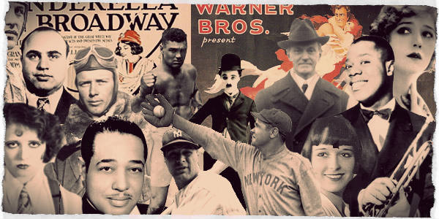
History in Fiction
Works of fiction help history come alive in a way that a timeline or a straight recounting of alleged events cannot.
“…the vicarious pleasure of Fitzgerald’s words and images remains: the ornate rooms, glowing to receive a thousand guests …. Gatsby delights so many readers in part because it is a book of symbolic senses, carefully designed to make the pleasure we imagine palpable” (Churchwell 72)
Notes:
Human interest is what draws readers and people in – Humans of New York

Slide 11
History in Fiction
East Egg vs West Egg – Old $$$ vs New $$$ - class distinction in a supposedly classless society -
“It was hard to realize that a man in my own generation was wealthy enough to do that”(6).
“Have you read ‘The Rise of the Colored Empires’ by this man Goddard?” (12).
Jazz History of the World; Simon Called Peter; Three O’Clock in the Morning; The Love Nest
“They were careless people, Tom and Daisy—they smashed up things and creatures and then retreated back into their money or their vast carelessness, or whatever it was that kept them together, and let other people clean up the mess they had made….” (179).
“… I became aware of the old island here that flowered once for Dutch sailors’ eyes—a fresh, green breast of the new world …” (180).

Slide 12
History in Fiction
“Gatsby is a modern Faust, who makes a fortune and in the process loses what once would have been called his soul.
The distortion is not just of vision, but of visionaries. America was inventing a country that would be unable to distinguish wonder from wealth, while telling itself that every day, in every way, it was growing better and better.”
-Sarah Churchwell, 304

Slide 13
Personally…
5 Film Adaptations
Timeless Questions
The American Dream?
Reliable Narrator?
Beautiful, sparing language and imagery
Mirrors some of our current cultural issues
Hopeful, if sad
- http://tinyurl.com/zcmjkw2

Slide 14
“Jay Gatsby's world-weary idealist, who knows how messed up life can be but still soldiers on in pursuit of his ideals, is the great American type. It showed up again in Rick Blaine of ''Casablanca,'' who seemed to have bitterly put himself on the sidelines but ultimately couldn't stop himself from doing his part for the anti-Nazi cause.
And it is the United States today. We are a land of Enron and Global Crossing, and of the reformist impulse to rewrite our securities and pension laws. We have the corruption of the campaign finance system and Beltway lobbying, and a new campaign finance law, passed to try to clean it up. And we are the nation that after the debacles of Vietnam and Somalia, still views itself as having a calling to wage war on terrorism worldwide. Americans have some of Holden Caulfield's allergy to phoniness, and of Atticus Finch's unidimensional moral fervor. But mainly we are Gatsby, flawed in a flawed world, but unable to resist the pull of the green light.”
-Adam Cohen (2002)

Slide 15
Works Consulted
Brown, Amanda Christy, and Katherine Schulten. "Teaching 'The Great Gatsby' With The New York Times." The New York Times. The New York Times Company, June 2013. Web. 04 Apr. 2016.
Churchwell, Sarah. Careless People: Murder, Mayhem, and the Invention of The Great Gatsby. New York: Penguin, 2013. Print.
Cohen, Adam. "Editorial Observer; Jay Gatsby, Dreamer, Criminal, Jazz Age Rogue, Is a Man for Our Times." The New York Times. The New York Times Company, 2002. Web. 04 Apr. 2016.
Crum, Maddie. "7 Life Lessons From 'The Great Gatsby'" The Huffington Post. TheHuffingtonPost.com, 24 Sept. 2013. Web. 04 Apr. 2016.
"F. Scott Fitzgerald (1896-1940)." The House of Scribner, 1905-1930. Ed. John Delaney. Vol. 16. Detroit: Gale, 1997. 152-176. Dictionary of Literary Biography Documentary Series Vol. 16. Dictionary of Literary Biography Documentary Series. Web. 4 Apr. 2016.
Fischer, Molly. "Saving Zelda." The New Yorker. Condé Nast, 2013. Web. 05 Apr. 2016.
Fitzgerald, F. Scott. The Great Gatsby. New York: Scribner’s, 2004.

